Slide 1

2019 Annual Review

Slide 2
CONTENTS
1
2018 & 2019 Contracts Review
2
Cognizant AMS Scope and Pipeline
3
Cognizant AMS 2019 Delivery Review
AMS Team Structure and Finance

Slide 3
2018 Service Procurement Summary
No. |  | Contract Name | Start Date | End Date | Amount with Tax | PM | Execution Status | Status
1 |  | AMS | 2018/1/1 | 2018/12/31 | 5,136,323.28 | Jacky Gao | ● | Complete
2 |  | AMS – AV/CDR | 2018/7/1 | 2018/12/31 | 207,018 | Jacky Gao | ● | Complete
4 |  | Content Author 2018 | 2018/1/1 | 2018/8/30 | 251,872 | Cao Wei | ● | Complete
5 |  | CR1700780开发 | 2017/12/31 | 2018/3/31 | 44,000 | Jiang Wei | ● | Complete
6 |  | MDES CR1600999 & CR1700352 | 2108/3/15 | 2018/4/30 | 31,800 | Jiang Wei | ● | Complete
7 |  | CR1800450开发 | 2018/8/31 | 2018/9/28 | 30,000 | Zhibing Xu | ● | Complete
8 |  | StructuredEnhancement-Wechat-CR170030 | 2017/9/1 | 2017/12/31 | 321,200 | Cindy Li | ● | Complete
Total（RMB） |  |  |  |  | 6,022,213.18
CR
● On track ● At risk ● Behind

Slide 4
2019 Service Procurement Summary
No. |  | Contract Name | Start Date | End Date | Amount with Tax | PM | Execution Status | Status
1 |  | AMS – OBS | 2019/1/1 | 2019/12/31 | 4,613,687.03 | Jacky Gao | ● | On-going
2 |  | AMS – CBS | 2019/1/1 | 2019/12/31 | 1,621,886.68 | Jacky Gao | ● | On-going
3 |  | CR1700922 One Quotation系统安全漏洞修复 | 2018/9/1 | 2019/5/27 | 93,000 | Zhenguo Jin | ● | Complete
Total（RMB） |  |  |  |  | 6,328,573.71
● On track ● At risk ● Behind

Slide 5
AMS current scope
AMS China Engagement kick started in Oct 2014 and entered into steady state in Q1 2015. The scope is to do Application maintenance support for 35 applications spanning across various technologies. The scope was updated in Nov 2019 as Cognizant won RFP for new scope.
AMS China – Key Business Area
Audit
Agent Management
Doc Management
IT Support
Communication
CIRC Audit
e-opening
iMap
FileNet
New Printing
Scanning
JIRA
EMS
SMS
Policy Management
Customer Service
Reporting
AURA
PASS
MDES
WTS
WeChat
DHT
eClaim
eNotice
CSO
CIRC
SMIS
SAP BO
Sales
Data Warehouse
iCare
Salesportal
MTS
One Quotation
Web Portal
DTC(SWAN)
Gonghui
Xiehui
RI-ETL
ODS
DM/TM BI
AMS China – Key Technologies
Java / .NET / WeChat / SAP-BO / Informatica / Cognos

Slide 6
Scope in-take of 2019 & Transition Pipeline
1. Cognizant AMS added the below scope in 2019:
eClaim
eNotice
iBox EB
2. Scope won in Nov 2019:
JIRA
VMS
DTC(SWAN)
3. Additional scope suggestion:
2019-2020 Pipeline: QA Automation, Treasure Management Platform, Fee Management System, NB Workflow, iMap2.0
To-be-determined: New Comp, Data Lake,中保信保单报送平台,IVR-TM,IVR-CS, i-Pay, iPartner, EZT, EB, ARS, BMP, EB WeChat, RPIS.

Slide 7

Key Highlight - 2019
No. | Application System | Description | Benefit
1 | All | Cognizant takes over AMS metrics reports for all vendors. Metrics include monthly ticket reports, SLA, etc. Cognizant team worked as liaison to manage other AMS vendor teams. | Additional contribution by Cognizant team to bring forward centralized reporting.
2 | ODS | ODS has a major change in Sep. The new environment is ODS backend database(SQLServer) which use solid state disk and has much more storage space, also the version is upgraded from 2008 to 2012, what we did is smooth code migration and performance comparison, avoid any impact of data pushing to downstream. | System performance is greatly improved.
3 | CIRC Reporting | Data model for CIRC Reporting failed to produce the required report for March. ODS engineers and CIRC engineers have worked together through over-time to optimize the data model and produced the reports timely. | Performance gain of monthly CIRC database reporting. Permanent fix of the issue. Estimated 0.2 FTE per month saving.
4 | iMap | Updated iOS certificate for MetLife China, so that all iOS systems can receive updated certificate, including iMap. Fixed historical issue of image overlay. 525365 policies scanned and fixed 1717 problematic policies. | iOS certificate is universally updated for all MetLife China iOS App’s. Estimated one time effort saving of 1 person month for automated image fixing.

Slide 8
Feedback and Improvement Plan
Feedback | Improvement Plan
DP is of high-risk. MetLife China need Cognizant’s help on AMS tools (such as DP tools and monitoring tools) and process maturity assessment to help MetLife China improve on operation maturity. | Cognizant team has been working on bringing best practices and tools from global delivery experience. Cognizant is to evaluate local adaptability of the BESsT tool. Cognizant has received some feedback on tool customization. Cognizant team is to onboard internal Delivery Excellence team to help with process maturity and annual assessment.
People professionalism improvement and “one-team” concept. | Cognizant AMS team will increase the frequency for domain knowledge training, including LOMA Insurance knowledge, ITIL knowledge, etc. , by leveraging Cognizant internal training libraries and Academy. Cognizant team to conduct business behavior training to help boost engineers’ professionalism and stress more on “one-team” concept in order to serve business users and AMS owners more pro-actively.

Slide 9
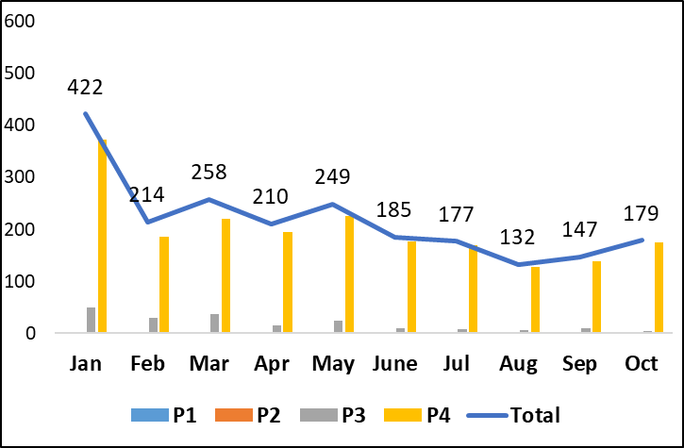
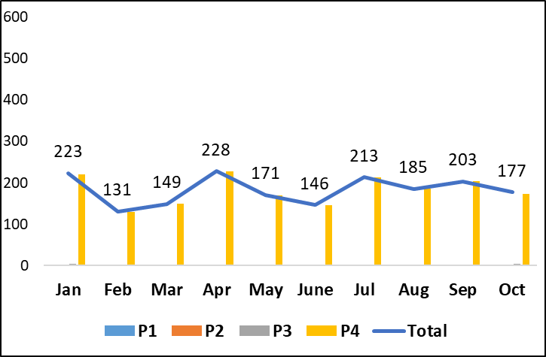
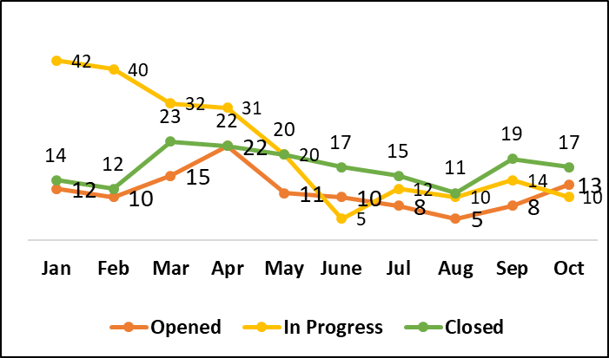
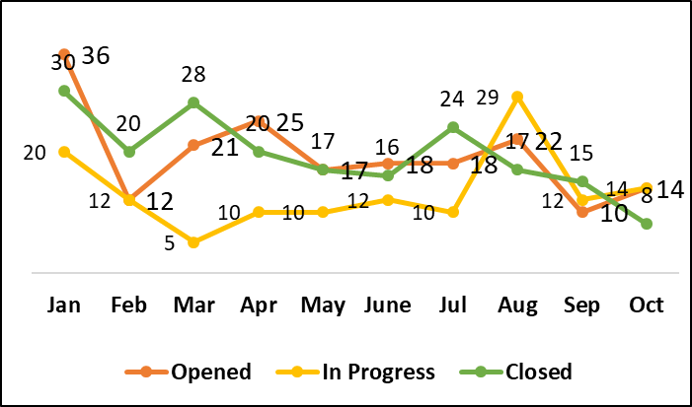
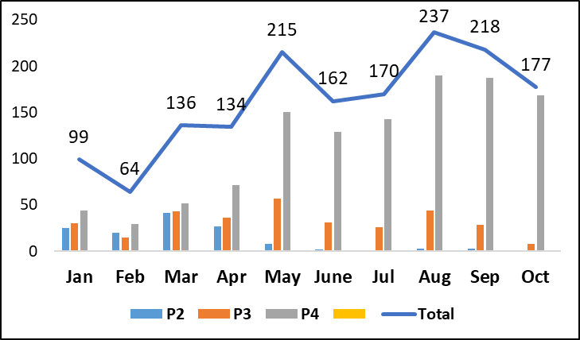
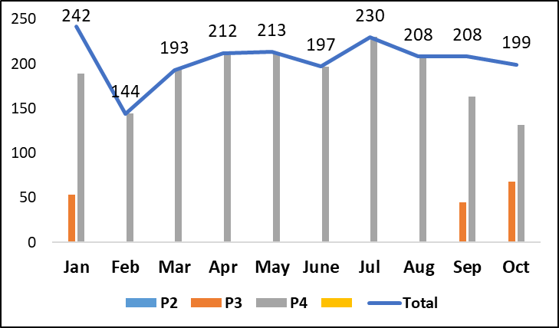
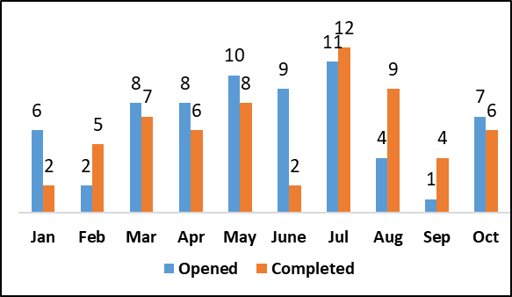
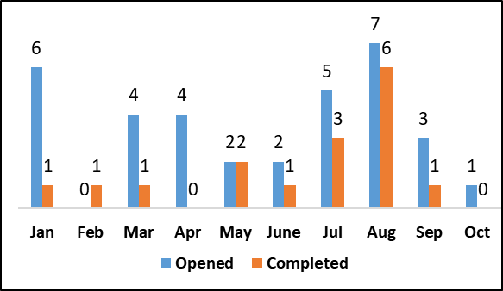
Delivery Snapshot
IM Ticket Trend – Jan-Oct 2018
IM Ticket Trend – Jan-Oct 2019
Problem Ticket Trend - Jan-Oct 2018
Problem Ticket Trend - Jan-Oct 2019
16% decrease in incident trend when compared from 2018(Average of 217) to current 2019(Average of 183)
Majority of the tickets from PASS , Wechat and MTS.
Problem tickets incoming rate has increased in 2019 compared to 2018.
SR Ticket Trend – Jan-Oct 2018
SR Ticket Trend – Jan-Oct 2019
WR trend – Prior – Jan-Oct 2018
WR trend – Prior – Jan-Oct 2019
27% Increase in SR trend when compared to 2018(Average of 161) to current 2019(average of 205).
CR intake and closure trend slightly reduced as more focus on application stabilization improvements

Slide 10
SLA Dashboard
SLA Metrics | Severity | Expected SLA | SLA | Jan’19 | Feb’19 | Mar’19 | Apr’19 | May’19 | Jun’19 | Jul’19 | Aug’19 | Sep’19
INC - Response time | P1 | 95% | 15 min | NA | NA | NA | NA | NA | NA | NA | NA | NA
 | P2 | 95% | 30 min | NA | NA | NA | NA | NA | NA | 100% | NA | NA
 | P3 | 90% | 1 hr | 100% | 100% | 100% | 100% | 100% | 100% | NA | NA | NA
 | P4 | 90% | 2 hrs | 91% | 90% | 94% | 92% | 96% | 97% | 93% | 97% | 98%
INC - Resolution Time | P1 | 100% | 2 hrs | NA | NA | NA | NA | NA | NA | NA | NA | NA
 | P2 | 91% | 3 hrs | NA | NA | NA | NA | NA | NA | 100% | NA | NA
 | P3 | 91% | 6 hrs | 100% | 100% | 100% | 100% | 100% | 100% | NA | NA | 100%
 | P4 | 91% | 8 hrs | 94% | 90% | 93% | 90% | 92% | 96% | 97% | 91% | 98%
SR - Response time | P2 | 95% | 30 min | NA | NA | NA | NA | NA | NA | NA | NA | NA
 | P3 | 90% | 1 hr | 100% | NA | NA | NA | NA | NA | NA | NA | NA
 | P4 | 90% | 2 hrs | 90% | 90% | 90% | 90% | 90% | 90% | 93% | 95% | 91%
SR - Resolution Time | P2 | 91% | 1 BD | NA | NA | NA | NA | NA | NA | NA | NA | NA
 | P3 | 91% | 3 BD | 100% | NA | 100% | 100% | 100% | 100% | 100% | 100% | 95%
 | P4 | 91% | 5 BD | 100% | 100% | 99% | 100% | 100% | 100% | 100% | 100% | 93%
SLA Analysis:
SLA has been all green for year 2019 with MetLife China unified SLA report.

Slide 11


